Slide 1
CAPSTONE PROJECT
SQL
PYTHON
TABLEAUE
MENTOR NAME : JAYA PANDEY
STUDENT NAME : AVINAASH ALFRED

Slide 2
CONTENTS IN SQL
INTRODUCTION
OBJECTIVES
DATA ANALYSIS USING SQL QUESTIONS AND ANSWERS
OUTPUTS
OBSERVATION
CONCLUSION

Slide 3
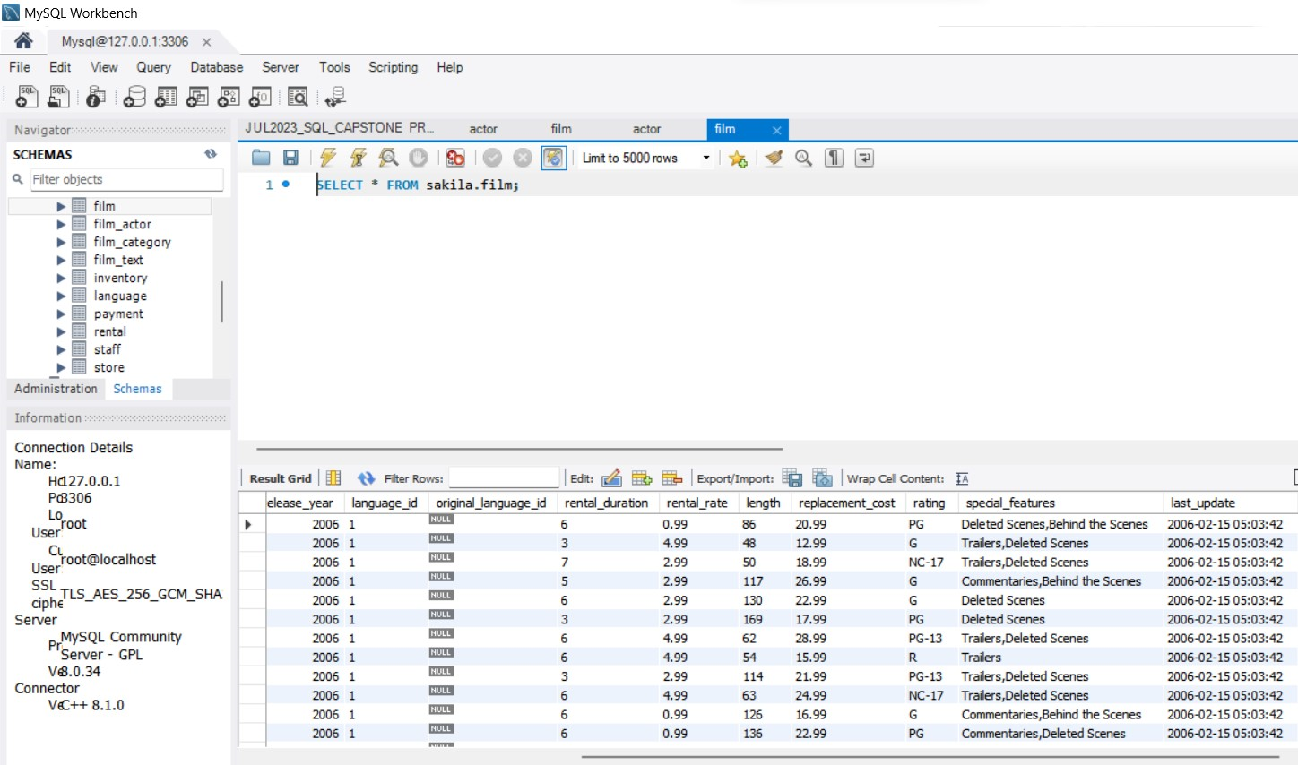
INTRODUCTION
Movie rental data analysis in SQL involves examining and extracting insights from a dataset related to movie rentals.
This data could be from a database that records customer transactions, rental details, and movie information.
SQL (Structured Query Language) is a powerful tool for managing and analyzing such data.
Movie rental data analysis in SQL can provide valuable information for businesses in the entertainment industry, including movie rental stores or streaming platforms, to make data-driven decisions and improve their services.
The Sakila Database is a commonly used sample database that provides a realistic and comprehensive schema for practicing and learning various aspects of relational database management systems (RDBMS) and SQL. It was created by the MySQL team to serve as a practical resource for developers, students, and educators who are interested in understanding database concepts and gaining hands-on experience in SQL query writing.

Slide 4
OBJECTIVES
Understanding database structure: Sakila Database helps in understanding the structure of a typical relational database system, including tables, relationships, and data types.
Practicing SQL queries: Users can practice and enhance their SQL skills by writing and executing various types of SQL queries, including SELECT, INSERT, UPDATE, and DELETE statements.
Learning database management concepts: Sakila Database enables users to learn essential database management concepts such as data retrieval, data manipulation, data modeling, and database normalization.
Analyzing data: Users can learn to analyze data by using SQL queries to retrieve specific information, perform calculations, and generate meaningful insights from the database.
Understanding database relationships: Sakila Database provides examples of various types of database relationships, including one-to-one, one-to-many, and many-to-many relationships, allowing users to comprehend these concepts practically.
Exploring database functions: Users can explore and practice various database functions, such as aggregate functions, string functions, and date functions, to manipulate and process data within the database.

Slide 5
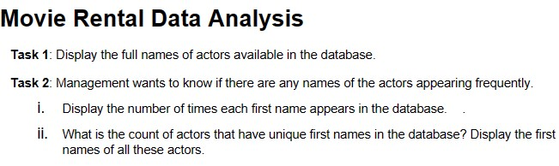
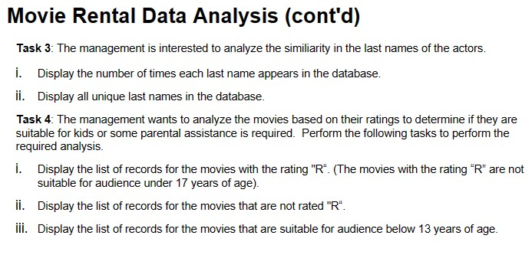
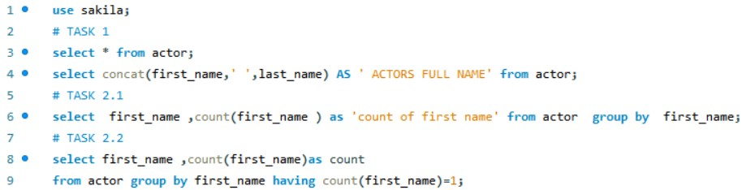
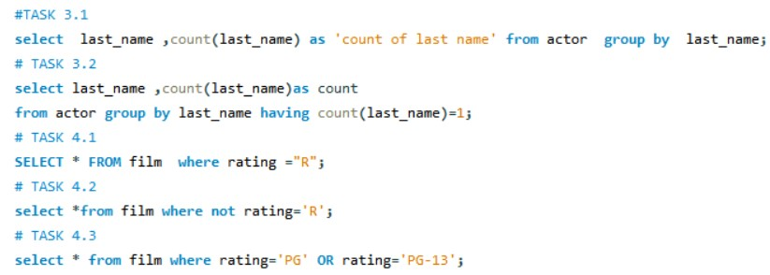
DATA ANALYSIS USING SQL QUESTIONS AND ANSWERS

Slide 6
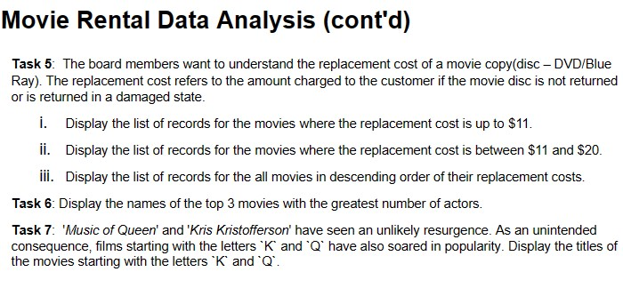
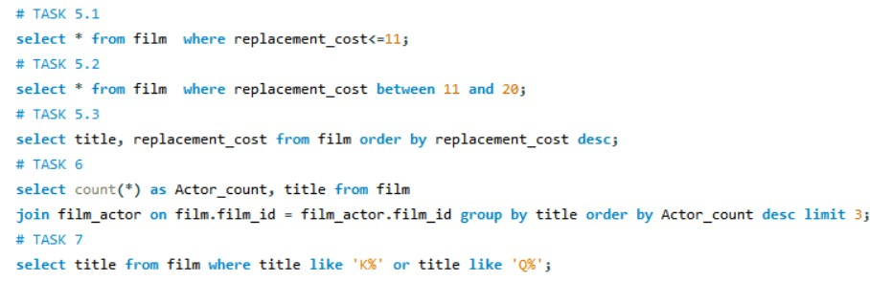
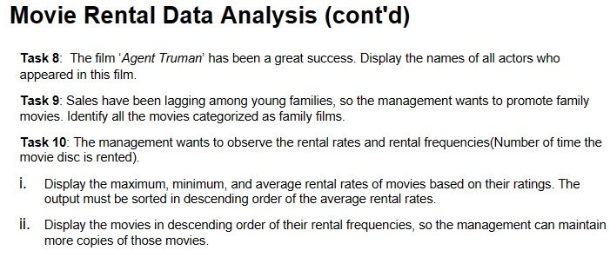
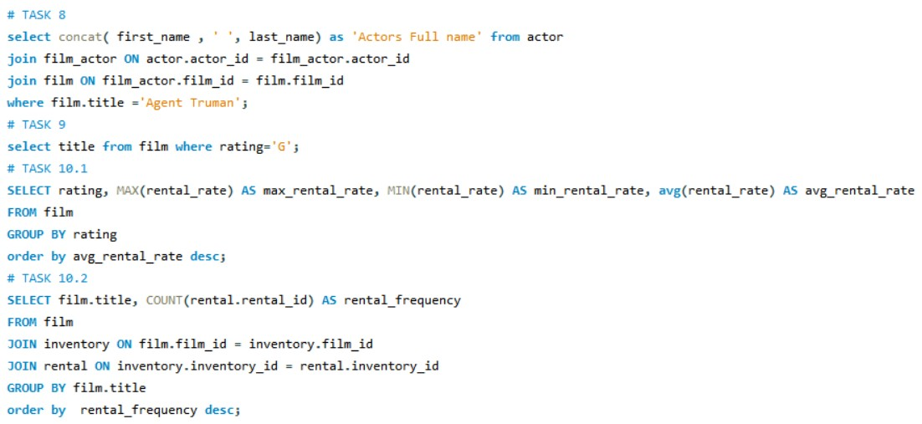
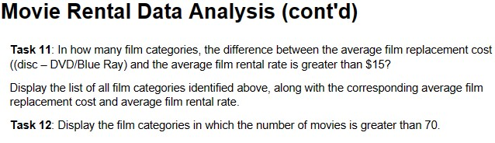
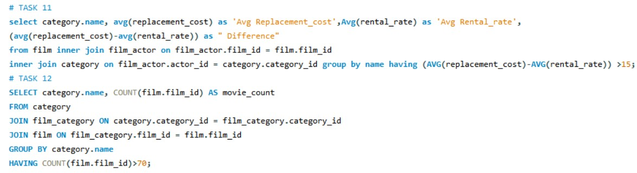

Slide 7
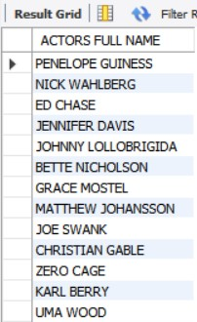
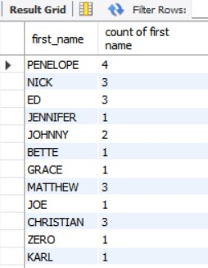
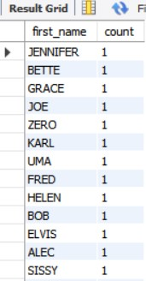
OUTPUTS
TASK 1
TABLE NAME : For task 1 actor table is used.
COLUMN NAME : First name and last name has been used.
TECHNIQUES : To join the two columns I have used concatenate function
INTERPRETATION : This columns shows full name of the actors.
TASK 2.1
TASK 2.2
TABLE NAME : For the task 2.1 and 2.2 actor table is used.
COLUMN NAME : First name has been used.
TECHNIQUES : To calculate the count I have used count aggregation, group by and having clause.
INTERPRETATION : 1.The task 2.1 shows the count of first name.
2.The task 2.2 shows the first name who having count 1

Slide 8
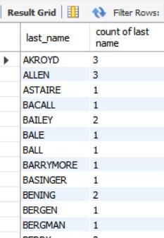
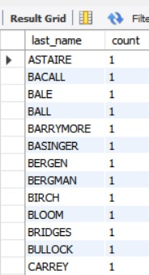
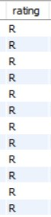
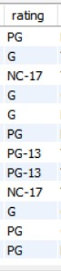
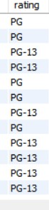
TASK 3.1
TASK 3.2
TABLE NAME : For the task 3.1 and 3.2 actor table is used.
COLUMN NAME : Last name has been used.
TECHNIQUES : To calculate the count I have used count aggregation, group by and having clause.
INTERPRETATION : 1.The task 3.1 shows the count of last name.
2.The task 3.2 shows the last name who having count 1.
TASK 4.1
TASK 4.2
TASK 4.3
TABLE NAME : For the task 4.1,4.2 and 4.3 film table is used.
COLUMN NAME : For all the 3 tasks rating has been used.
TECHNIQUES : Here where clause and not ,or logical operator has been used.
INTERPRETATION : 1.The task 4.1 shows the rating = R.
2.The task 4.2 shows the not rating = R.
3.The tasks 4.3 shows the both PG OR PG – 13.

Slide 9
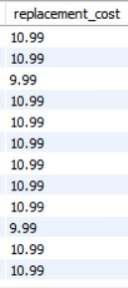
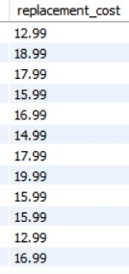
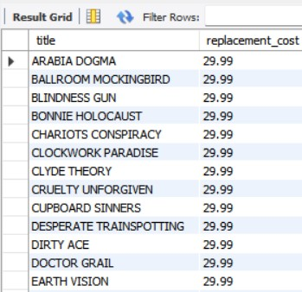
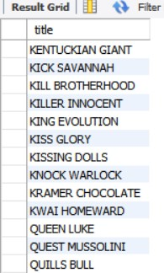
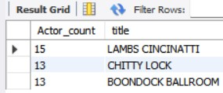
TASK 5.1
TASK 5.2
TASK 5.3
TABLE NAME : For the task 5.1,5.2 and 5.3 film table is used.
COLUMN NAME : For all the 3 tasks replacement cost has been used.
TECHNIQUES : Here where ,order by clause and between, desc ,and operator has been used.
INTERPRETATION : 1.The task 5.1 shows the replacement cost <= 11.
2.The task 5.2 shows the replacement cost between 11 and 20.
3.The tasks 5.3 shows the title and replacement cost in descending order.
TASK 7
TASK 6
TABLE NAME : For the task 6 and 7 film table is used.
COLUMN NAME : For all the 2 tasks title has been used.
TECHNIQUES : I have used join and on ,group by ,order by ,where clause ,like ,or operator is used.
INTERPRETATION : 1.The task 6 shows the title ,sort in descending order and count of actor limit till 3.
2.The task 7 shows the title starting from the letter K and Q.

Slide 10
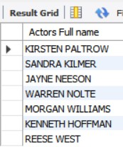
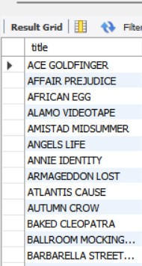
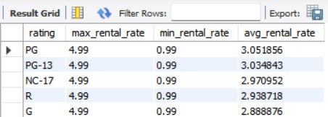
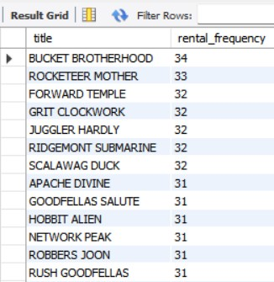
TASK 8
TASK 9
TABLE NAME : For the task 8 and 9 from actor and film table is used.
COLUMN NAME : For all the 2 tasks first and last name ,title has been used.
TECHNIQUES : I have used concatenate function ,where and on clause is used.
INTERPRETATION : 1.The task 8 shows actors full name for the title agent truman.
2.The task 9 shows the title for the rating = G.
TASK 10.1
TASK 10.2
TABLE NAME : For the task 10.1 and 10.2 from film table is used.
COLUMN NAME : For all the 2 tasks rating ,title ,rental rate has been used.
TECHNIQUES : I have used maximum, minimum ,average, count aggregate function ,where and group by, order by clause is used.
INTERPRETATION : 1.The task 10.1 shows maximum ,minimum average of rental rate.
2.The task 10.2 shows the count of rental id as rental frequency.

Slide 11
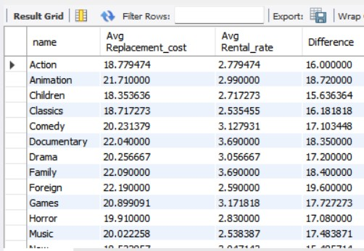
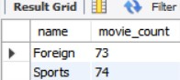
TASK 11
TABLE NAME : For the task 11 film table is used.
COLUMN NAME : For this task name ,rental rate ,replacement cost has been used.
TECHNIQUES : I have used average aggregate function ,group by ,having, on clause and join is used.
INTERPRETATION : The task 11 shows the average rental rate and replacement cost to calculate the difference of the both to display the category name.
TASK 12
TABLE NAME : For the task 12 category table is used.
COLUMN NAME : For this task name ,film id has been used.
TECHNIQUES : I have used count aggregate function ,group by ,having, on clause and join is used.
INTERPRETATION : The task 12 shows the count of movie for this specific category name.

Slide 12
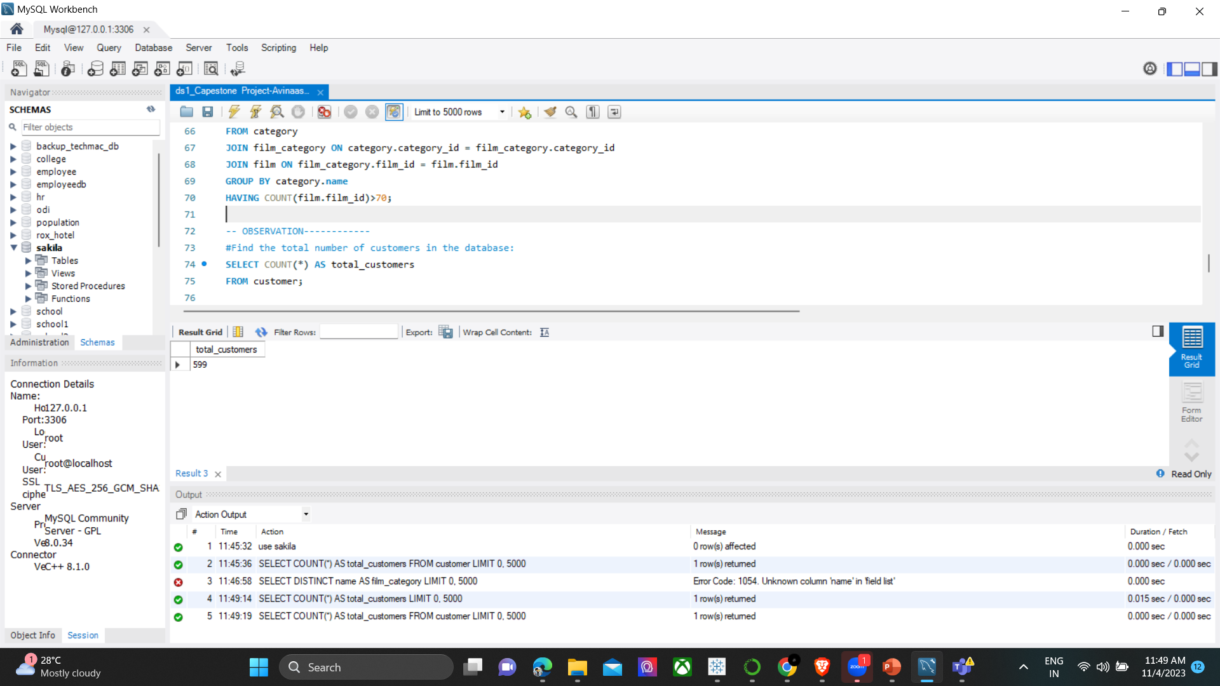
OBSERVATION
OBSERVATION POINTS:
1.THE TOTAL NUMBER OF CUSTOMER IN THE DATA BASE IS IDENTIFIED BECAUSE SAKILA DATA BASE IS BASED OUT OF PEOPLE
2.THERE ARE 599 TOTAL CUSTOMERS IN THE DATA BASE

Slide 13
CONCLUSION
Learning tool: The Sakila Database serves as an effective educational tool for individuals to gain hands-on experience in working with a relational database, allowing them to understand database design, implementation, and querying.
Comprehensive schema: The database's well-structured schema provides a diverse range of tables, including those for films, actors, customers, stores, and rentals, enabling users to practice various types of SQL queries and transactions.
Real-world relevance: The Sakila Database reflects a simplified yet realistic model of a DVD rental store, making it relevant for individuals aspiring to work in fields related to data management, software development, and analytics.
Query practice: Users can practice a wide range of SQL queries, including basic retrieval, filtering, joining, and aggregating data, enabling them to refine their skills and understanding of database operations.
Understanding relationships: The database's schema illustrates different types of relationships between entities, helping users grasp the concept of data normalization and the importance of maintaining data integrity.

Slide 14
THANK YOU

